Slide 1




Slide 2
INTRODUCTION

Slide 3
JavaScript can make websites more interactive, interesting, and user-friendly.

Slide 4
JavaScript is one of a constellation of languages that support websites.

Slide 5
Web Development
CSS
Server-side Scripting (PHP, Ruby, Python, C#, JavaScript!)
HTML
JavaScript

Slide 6
LEARNING JAVASCRIPT INVOLVES LEARNING…

Slide 7
1

Slide 8
1
BASIC PROGRAMMING CONCEPTS
Including the terms programmers use to describe them

Slide 9
2
1
BASIC PROGRAMMING CONCEPTS
Including the terms programmers use to describe them

Slide 10
2
1
BASIC PROGRAMMING CONCEPTS
Including the terms programmers use to describe them
THE LANGUAGE ITSELF
Its vocabulary and how to structure your sentences

Slide 11
3
1
2
BASIC PROGRAMMING CONCEPTS
Including the terms programmers use to describe them
THE LANGUAGE ITSELF
Its vocabulary and how to structure your sentences

Slide 12
1
2
3
BASIC PROGRAMMING CONCEPTS
Including the terms programmers use to describe them
THE LANGUAGE ITSELF
Its vocabulary and how to structure your sentences
HOW IT IS APPLIED
Looking at examples of how it is commonly used

Slide 13
HOW JAVASCRIPT MAKES WEB PAGES MORE INTERACTIVE

Slide 14
JavaScript lets you access and modify the content and markup of web pages as the user is viewing them.

Slide 15
1. ACCESS CONTENT
Select text, elements, or attributes on an HTML page

Slide 16
1. ACCESS CONTENT
Select text, elements, or attributes on an HTML page
2. MODIFY CONTENT
Add text, elements, or attributes to an HTML page (or remove them)

Slide 17
1. ACCESS CONTENT
Select text, elements, or attributes on an HTML page
2. MODIFY CONTENT
Add text, elements, or attributes to an HTML page (or remove them)
3. PROGRAM RULES
Specify a set of steps for the browser to follow (like a recipe)

Slide 18
1. ACCESS CONTENT
Select text, elements, or attributes on an HTML page
2. MODIFY CONTENT
Add text, elements, or attributes to an HTML page (or remove them)
3. PROGRAM RULES
Specify a set of steps for the browser to follow (like a recipe)
4. REACT TO EVENTS
Tell a script to run when a specific event has occurred

Slide 19
CHAPTER 1 THE ABC OF PROGRAMMING

Slide 20
A

Slide 21
WHAT IS A SCRIPT AND HOW DO I CREATE ONE?

Slide 22
A script is a series of instructions that a computer can follow to achieve a goal.

Slide 23

YOU CAN COMPARE SCRIPTS TO: Recipes Handbooks Manuals

Slide 24
WRITING A SCRIPT

Slide 25
1

Slide 26
1
DEFINE THE GOAL
What do you want to achieve?

Slide 27
2
1
DEFINE THE GOAL
What do you want to achieve?

Slide 28
2
1
DEFINE THE GOAL
What do you want to achieve?
DESIGN THE SCRIPT
Split the goal into a series of tasks

Slide 29
3
1
2
DEFINE THE GOAL
What do you want to achieve?
DESIGN THE SCRIPT
Split the goal into a series of tasks

Slide 30
1
2
3
DEFINE THE GOAL
What do you want to achieve?
DESIGN THE SCRIPT
Split the goal into a series of tasks
CODE EACH STEP
Using the JavaScript language

Slide 31
B

Slide 32
HOW DO COMPUTERS FIT IN WITH THE WORLD AROUND THEM?

Slide 33

Here is a model of a hotel, along with some trees, people, and cars.

Slide 34
To a human, it is clear what kind of real-world object each one represents.
OBJECT TYPE: HOTEL
OBJECT TYPE: CAR
OBJECT TYPE: CAR

Slide 35
Computers create models of the world using data.

Slide 36
The objects in these models use properties, events, and methods.

Slide 37
PROPERTIES

Slide 38
Properties tell the computer about the characteristics of an object.

Slide 39
OBJECT TYPE: HOTEL
PROPERTIES
name Quay
rating 4
rooms 42
bookings 21
gym false
pool true

Slide 40
EVENTS

Slide 41
Events tell the computer how the user can interact with an object.

Slide 42
OBJECT TYPE: HOTEL
EVENT happens when:
book reservation is made
cancel reservation is cancelled

Slide 43
METHODS

Slide 44
Methods tell the computer how to change the properties of an object.

Slide 45
OBJECT TYPE: HOTEL
METHOD what it does:
makeBooking() increases value of bookings PROPERTY
cancelBooking() decreases value of bookings property
checkAvailability() subtracts value of bookings property from value of rooms property and returns number of rooms available

Slide 46
Here is the data the computer might use to make a model of one of the cars.

Slide 47
OBJECT TYPE: CAR
EVENT happens when: method called:
brake driver slows down changeSpeed()
accelerate driver speeds up changeSpeed()
PROPERTIES
make BMW
currentSpeed 45mph
color silver
fuel diesel
METHOD what it does:
changeSpeed() increases or decreases value of currentSpeed property

Slide 48
OBJECT TYPE: CAR
EVENT happens when: method called:
brake driver slows down changeSpeed()
accelerate driver speeds up changeSpeed()
PROPERTIES
make BMW
currentSpeed 45mph
color silver
fuel diesel
METHOD what it does:
changeSpeed() increases or decreases value of currentSpeed property

Slide 49
OBJECT TYPE: CAR
EVENT happens when: method called:
brake driver slows down changeSpeed()
accelerate driver speeds up changeSpeed()
PROPERTIES
make BMW
currentSpeed 45mph
color silver
fuel diesel
METHOD what it does:
changeSpeed() increases or decreases value of currentSpeed property

Slide 50
OBJECT TYPE: CAR
EVENT happens when: method called:
brake driver slows down changeSpeed()
accelerate driver speeds up changeSpeed()
PROPERTIES
make BMW
currentSpeed 45mph
color silver
fuel diesel
METHOD what it does:
changeSpeed() increases or decreases value of currentSpeed property

Slide 51
OBJECT TYPE: CAR
EVENT happens when: method called:
brake driver slows down changeSpeed()
accelerate driver speeds up changeSpeed()
PROPERTIES
make BMW
currentSpeed 30mph
color silver
fuel diesel
METHOD what it does:
changeSpeed() increases or decreases value of currentSpeed property

Slide 52
WEB BROWSERS

Slide 53
Web browsers use models of the browser window and the web pages contained in them.

Slide 54

OBJECT TYPE: WINDOW
PROPERTIES
location http://www.javascriptbook.com/
OBJECT TYPE: DOCUMENT
PROPERTIES
URL http://www.javascriptbook.com/
lastModified 09/04/2014 15:33:37
title Learn JavaScript & jQuery - A book that teaches you in a nicer way

Slide 55
Web browsers use these models to understand how to interpret web pages.

Slide 56
1

Slide 57
1
The browser receives a web page

Slide 58
<DOCTYPE html> <html> <head> <title>Constructive &amp; Co</title> <link rel=“stylesheet” href=“c01.css” /> </head> <body> <h1>Constructive &amp; Co</h1> <p>For all orders and enquiries, please call <em>555-3344</em></p> </body> </html>

Slide 59
2
1
The browser receives a web page

Slide 60
2
1
The browser receives a web page
It creates a model of the page and stores it in memory

Slide 61
OBJECT
document

Slide 62
OBJECT
ELEMENT
document
<html>
<head>
<body>
<title>
<link>
<h1>
<p>
<em>

Slide 63
OBJECT
ELEMENT
TEXT
document
<html>
<head>
<body>
<title>
<link>
<h1>
<p>
Constructive &amp; Co.
Constructive &amp; Co.
For all orders and inquiries please call
<em>
555-3344

Slide 64
OBJECT
ELEMENT
TEXT
ATTRIBUTE
document
<html>
<head>
<body>
<title>
<link>
<h1>
<p>
Constructive &amp; Co.
rel stylesheet
href css/c01.css
Constructive &amp; Co.
For all orders and inquiries please call
<em>
555-3344

Slide 65
3
1
2
The browser receives a web page
It creates a model of the page and stores it in memory

Slide 66
1
2
3
The browser receives a web page
It creates a model of the page and stores it in memory
It shows the page on screen using a rendering engine

Slide 67


Slide 68
C

Slide 69
HOW DO I WRITE A SCRIPT FOR A WEB PAGE?

Slide 70
It is necessary to know how JavaScript works with HTML and CSS in a web page.

Slide 71
PROGRESSIVE ENHANCEMENT

Slide 72
1

Slide 73
1
Content
.html

Slide 74
2
1
Content
.html

Slide 75
2
1
Content
Presentation
.html
.css

Slide 76
3
1
2
Content
Presentation
.html
.css

Slide 77
2
1
3
Content
Presentation
Behavior
.html
.css
.js

Slide 78
.html
.css
.js

Slide 79
.css
.html
.js

Slide 80
.css
.html
.js

Slide 81
.js
.css
.html

Slide 83
CREATING A BASIC JAVASCRIPT

Slide 84
JavaScript is written in plain text, just like HTML and CSS.

Slide 85
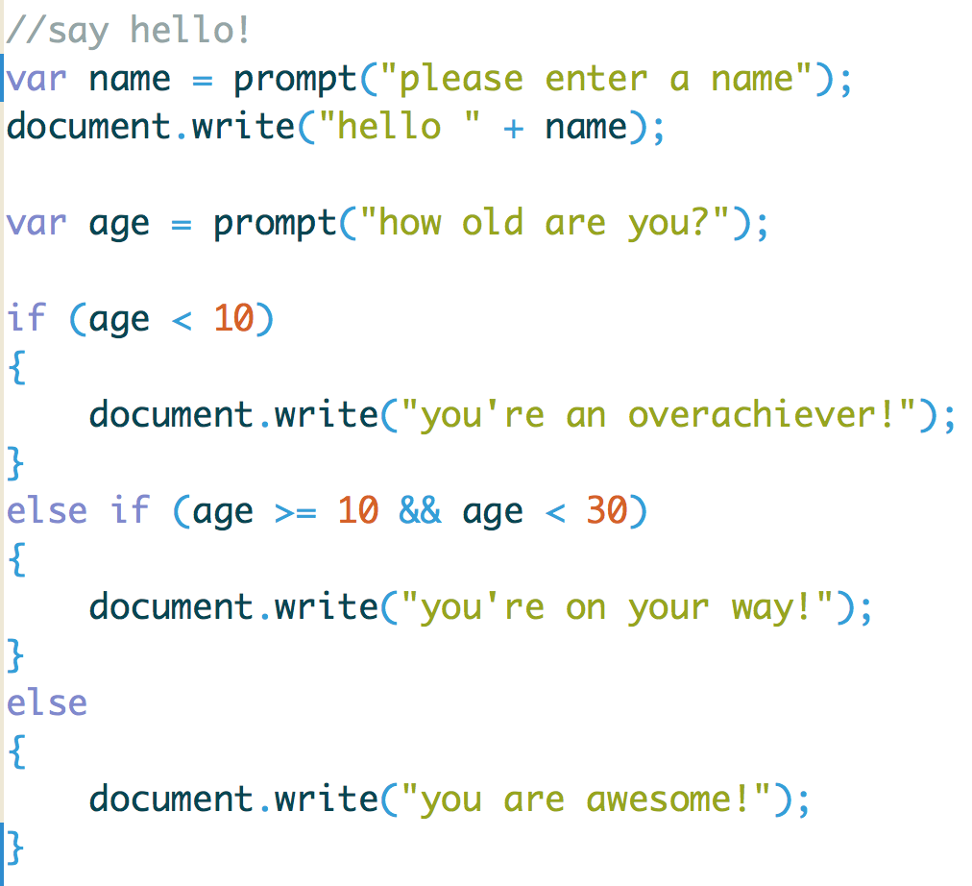
Example Script

Slide 86
document.write(‘Welcome!’);

Slide 87
document.write(‘Welcome!’);
OBJECT

Slide 88
document.write(‘Welcome!’);
MEMBER OPERATOR

Slide 89
document.write(‘Welcome!’);
METHOD

Slide 90
document.write(‘Welcome!’);
ARGUMENTS / PARAMETERS

Slide 91
Welcome!

Slide 92
LINKING TO A JAVASCRIPT FILE FROM AN HTML PAGE

Slide 93
You use the HTML <script> element. Its src attribute tells the browser where the JavaScript file is located.

Slide 94
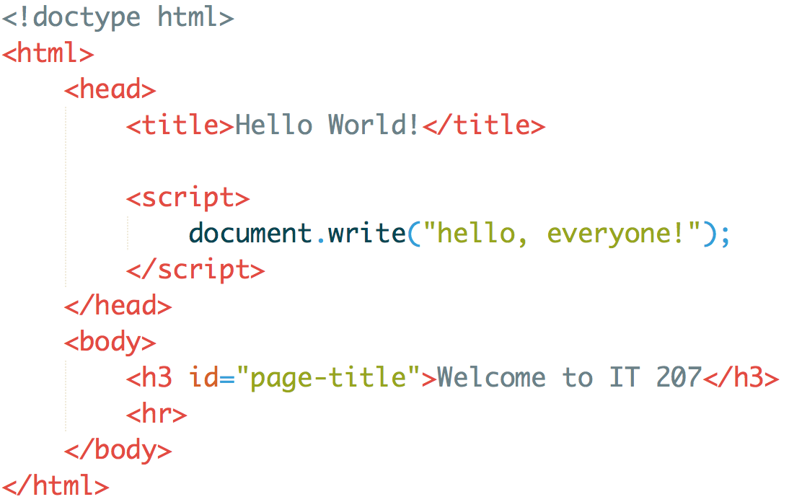
Example Script

Slide 95
JAVASCRIPT RUNS WHERE IT IS FOUND IN THE HTML

Slide 96
When the browser encounters a <script> element it: Stops to load the script Checks to see if it needs to perform any actions

Slide 97
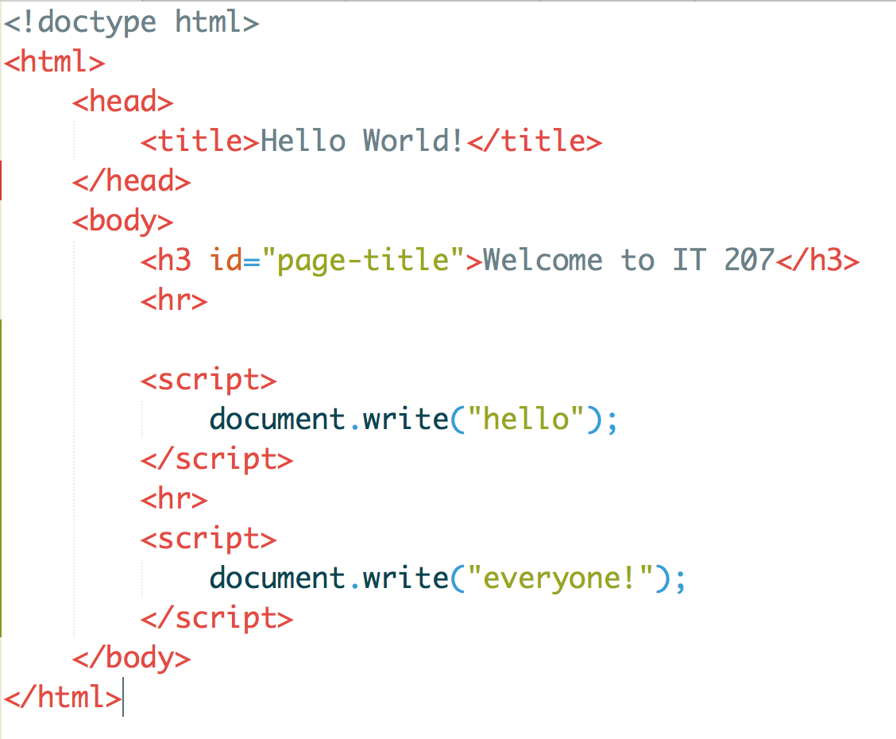
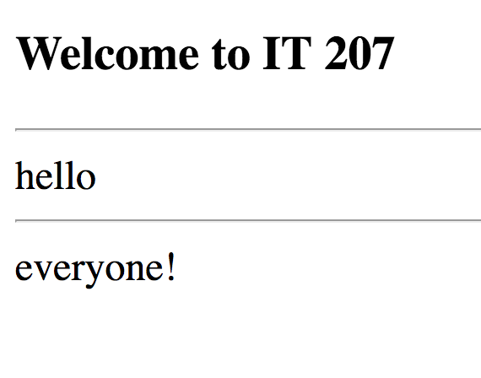
Example Script

Slide 98
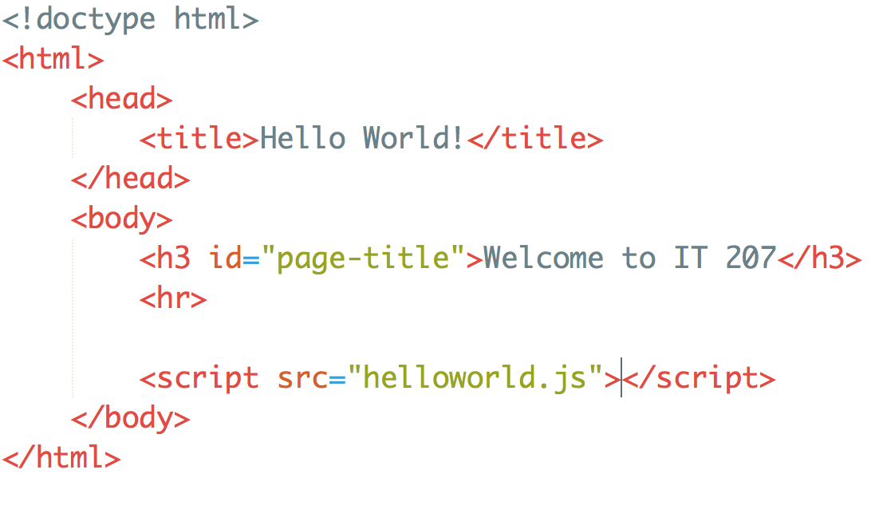
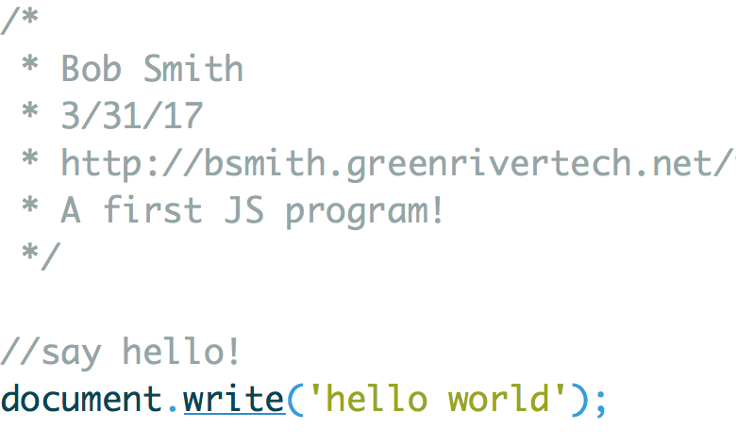
Developers avoid adding script tags with JavaScript directly in an HTML file
Instead place your JavaScript in an external file (with a .js extension)

Slide 99


